Slide 1
General Objective
Students will be able to understand the Object oriented systems development life cycle.

Slide 2
Specific Objectives
Students will be able to :
List the three transformation of software development process [R,C,T].
Examine the need of building high quality software [An,C,T].
Discuss a Use case driven approach [U,C,T].

Slide 3
Introduction
Analysis, design, implementation, testing & refinement to transform users’ need into software solution that satisfies those needs
Object-oriented approach
more rigorous process to do things right
more time spent on gathering requirements, developing requirements model & analysis model, then turn into design model
need not see code until after 25% development time

Slide 4
Software Development Life Cycle (SDLC)
Software Development Life Cycle (SDLC) is a process used by the software industry to design, develop and test high quality softwares.
The SDLC aims to produce a high-quality software that meets or exceeds customer expectations, reaches completion within times and cost estimates.
SDLC is a framework defining tasks performed at each step in the software development process.

Slide 5
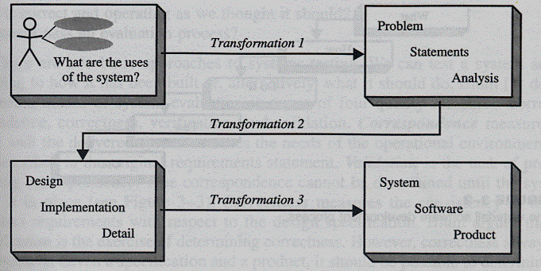
SO1: List the three transformation of software development process [U][C][T]

Slide 6
transformation 1(analysis) - translates user’s need into system’s requirements & responsibilities
transformation 2 (design) - begins with problem statement, ends with detailed design that can be transformed into operational system
transformation 3 (implementation) - refines detailed design into system deployment that will satisfy user’s needs

Slide 7
SDLC Models
Waterfall Model
Iterative Model
Spiral Model
V-Model
Big Bang Model

Slide 8
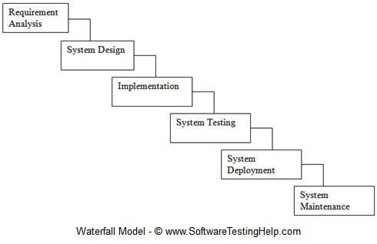
Waterfall software development process

Slide 9
Why waterfall model fails?
When there is uncertainty regarding what’s required or how it can be built
Assumes requirements are known before design begins
Assumes requirements remain static over development cycle
Assumes sufficient design knowledge to build product
Problem if environment changes

Slide 10
SO2:Examine the need of building high quality software [An,C,T]
Goal is user satisfaction
To achieve high quality in software we need to be able to answer the following questions
how do we determine system is ready for delivery?
Is it now an operational system that satisfies user ' s needs?
Is it correct and operating as we thought it should ?
Does it pass an evaluation process ?

Slide 11
Approaches to systems testing
Test according to
how it has been built
what it should do
4 quality measures
1.correspondence
measures how well delivered system matches needs of operational environment, as described in original requirements statement
2.validation
task of predicting correspondence (true correspondence only determined after system is in place)

Slide 12
3. correctness
measures consistency of product requirements with respect to design specification
4. Verification
Exercise of determining correctness (correctness objective => always possible to determine if product precisely satisfies requirements of specification)

Slide 13
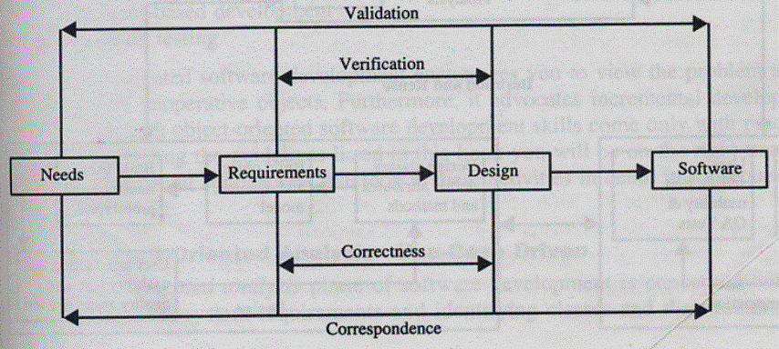

Slide 14
Verification vs Validation
Verification
– am I building the product right ?
– Begin after specification accepted
Validation
– am I building the right product ?
– Begins as soon as project starts
Verification & validation independent of each other

Slide 15
SO3: Object-Oriented pproach: A use-case driven approach[U][C][T]
Object-oriented software development life cycle consists of
Object-oriented analysis
Object-oriented design
Object-oriented implementation

Slide 16
Object–Oriented Analysis
In this stage, the problem is formulated, user requirements are identified, and then a model is built based upon real–world objects.
The analysis produces models on how the desired system should function and how it must be developed.
The models do not include any implementation details so that it can be understood and examined by any non–technical application expert.

Slide 17
Object–Oriented Design
System Design
In this stage, the complete architecture of the desired system is designed.
System design is done according to both the system analysis model and the proposed system architecture.
Object Design
In this phase, a design model is developed based on both the models developed in the system analysis phase and the architecture designed in the system design phase. All the classes required are identified.

Slide 18
The designer decides whether −
new classes are to be created from scratch,
any existing classes can be used in their original form, or
new classes should be inherited from the existing classes.
The associations between the identified classes are established and the hierarchies of classes are identified.
Besides, the developer designs the internal details of the classes and their associations, i.e., the data structure for each attribute and the algorithms for the operations.

Slide 19
Object–Oriented Implementation and Testing
In this stage, the design model developed in the object design is translated into code in an appropriate programming language or software tool.
The databases are created and the specific hardware requirements are ascertained.
Once the code is in shape, it is tested using specialized techniques to identify and remove the errors in the code.

Slide 20
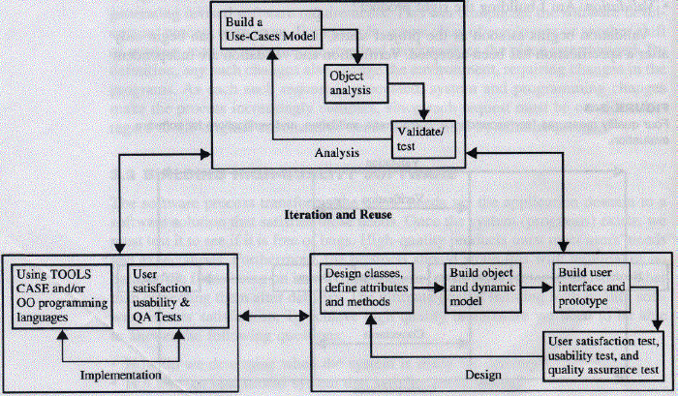
Object-oriented Systems Development Approach

Slide 21
Object-oriented software development activities
Object-oriented analysis - use case driven
Object-oriented design
Prototyping
Component-based development
Incremental testing

Slide 22
Summary
Software development process
High quality software
Verification
Validation

Slide 23
References
Ali Bahrami, Object Oriented Systems Development, Third Edition, Tata McGraw-Hill, 2012

Slide 24
Stimulating Questions
1. How is software verification different form validation?

Slide 25
Thank You !!!

